Slide 1

Violence Reporting System
Team Details:
 | Student Name | USN | Roll No. | Division
1. | Sagar Dodawad | 01FE21BCI010 | 109 | F
2 | Pratapkumar B | 01FE21BCS299 | 145 | A
3 | Abhishek Angadi | 01FE21BCI004 | 104 | F
4 | Vinod Pattar | 01FE21BCS182 | 232 | B
Guide: Prof. Preethi Y R

Slide 2
CONTENTS:
Problem Statement
Goal Alignment
Objectives
Functionalities
Non-Functionalities
Architecture Design
ER-Diagram
Result
Conclusion

Slide 3
Problem Statement:
Develop a web application where users can report incidents of violence and track their status, while administrators manage and update these reports to ensure timely and transparent resolution.

Slide 4
Goal Alignment:
Goal 16: Peace, Justice, and Strong Institutions
This goal aims to promote peaceful and inclusive societies for sustainable development, provide access to justice for all, and build effective, accountable, and inclusive institutions at all levels. Our platform's focus on reporting instances of violence contributes to Goal 16.

Slide 5
Objectives:
Provide a platform for users to report incidents of violence.
Enable users to track the status and updates of their reported issues.
Facilitate administrators in managing and updating the status of reported issues.
Ensure transparency and communication between users and administrators regarding the progress of each issue.

Slide 6
Functionalities:
1. User Registration and Authentication:
Implement secure authentication to allow users to log in and access their account.
2. Incident Reporting:
Users should be able to submit reports of violence incidents by providing a title, description, and uploading relevant images.
3. User Dashboard:
Users must have a dashboard where they can view a list of their submitted reports, its status , updates from admin
4. Admin Dashboard:
Administrators should have access to a dashboard displaying all reported incidents, categorized by status (Pending, In-Process, Solved, Spam).
Administrators must be able to update the status of any report and provide comments or updates.

Slide 7
Non Functionalities:
Security: Ensure secure user authentication and authorization. Protect user data and uploaded images from unauthorized access.
Performance: The system should handle concurrent user activities efficiently. Ensure fast response times for user actions and admin updates.
Usability: Provide an intuitive and user-friendly interface for both users and administrators.
Scalability: Design the system to handle an increasing number of users and reports.
Reliability: Ensure the system is consistently available and operational.

Slide 8
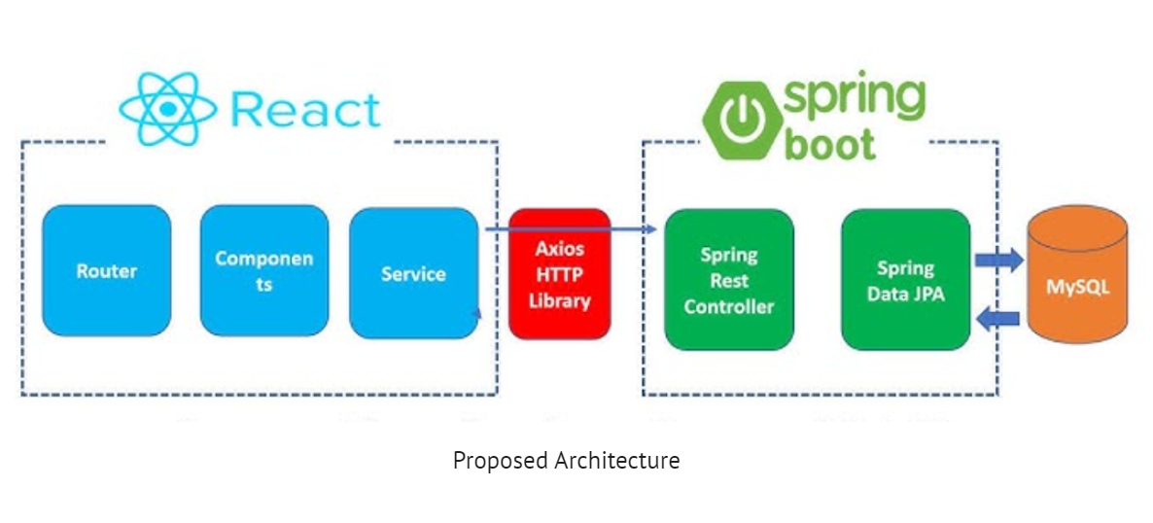
Architecture Design:

Slide 9
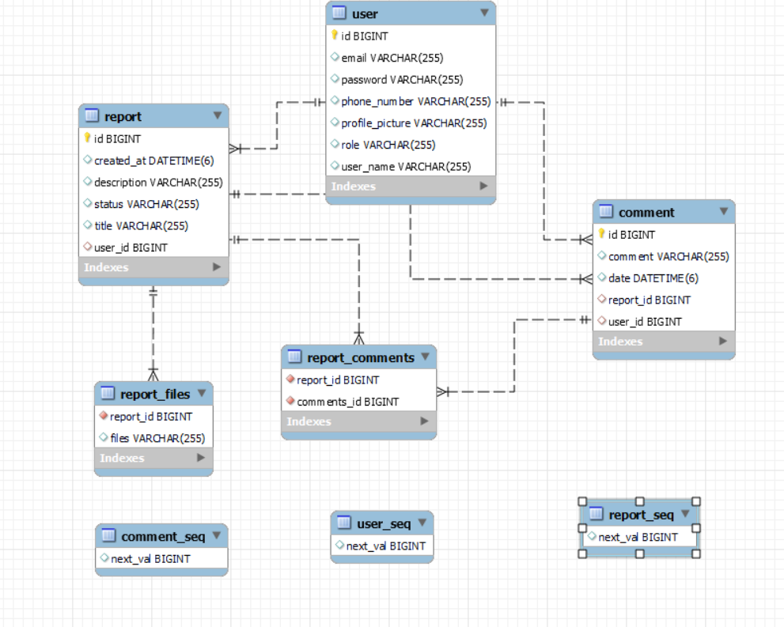
ER Diagram:

Slide 10
Conclusion:
This project has highlighted the powerful role of technology in promoting peace, justice, and strong institutions. By creating a platform for reporting and managing incidents of violence, we emphasized transparency and accountability, fostering more inclusive societies. The project improved our full-stack development skills, secure data handling, and user-centric design. Overcoming challenges enhanced our problem-solving abilities, balancing security with usability, and ensuring data consistency and scalability. The lessons learned will guide future projects, reinforcing our commitment to using technology for societal well-being.

Slide 11
THANK YOU

